Slide 1
Introduction to Image Processing and Analysis
July 20th and 22nd
How to load, read and obtain information from grayscale and color images
José Serrado Marques
Adapted from Nuno P Martins
1

Slide 2
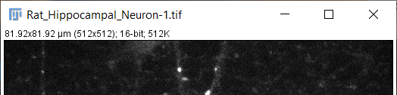
Open Fiji
File > Open Samples > Neurons
Read the info on the top of the image window
Image dimensions (in pixels); bit-depth; Image size
When images are not calibrated, image dimension show only the pixels
Notes:
When images are not calibrated, image dimension show is pixels

Slide 3
Show main Fiji controls
Let’s see look at image histogram and pixel information
Use line tool to measure the length of a dendrite
Measure the area of the cell body (soma).
Open embryos. Set scale and measure embryos area.
Notes:
Até aqui é capaz de ser 15-25 minutos.

Slide 4
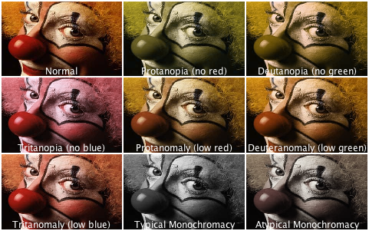
Images in Color and Color images
https://www.osapublishing.org/oe/fulltext.cfm?uri=oe-21-8-9862&id=252779
https://thenode.biologists.com/data-visualization-with-flying-colors/research/
Notes:
Linha de cima, composite. Em baixo é tipos de daltonimos

Slide 5
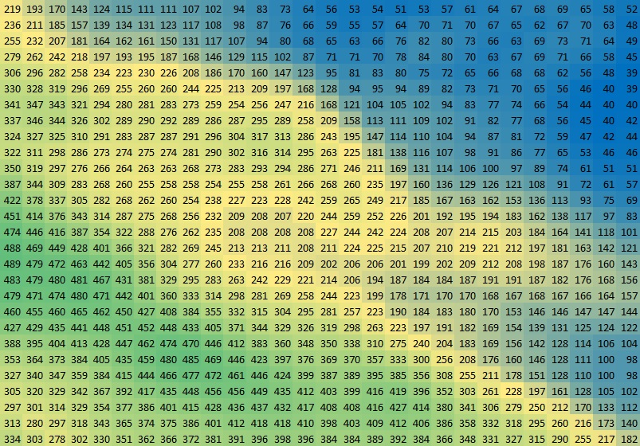
Color in images
Pixel values are the information on the image, not the color.
Color is displayed according to a Lookup Table – LUT, for better visualization.

Slide 6
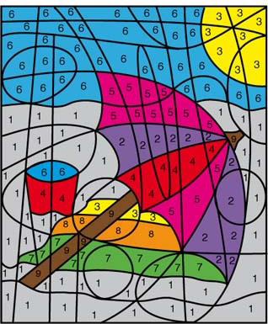
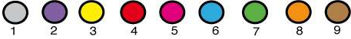
What is a Lookup Table?
A look up table maps the 255 intensity values to 255 arbitrary colors
Screens can only project/make 255 colors per channel (Red, Green, Blue)
A pixel value will correspond to a specific color of the LUT.

Slide 7
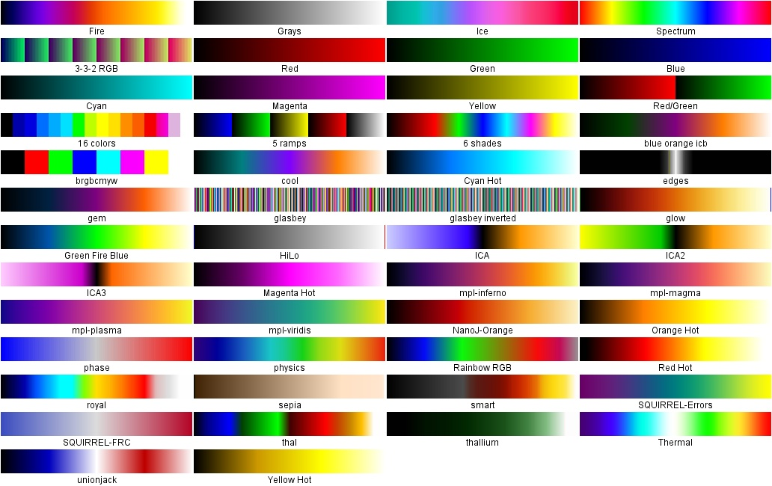
LUTs built-in
Live Demo:
Let's play with LUTs on the neuron image
Image > Color > Display LUTs

Slide 8
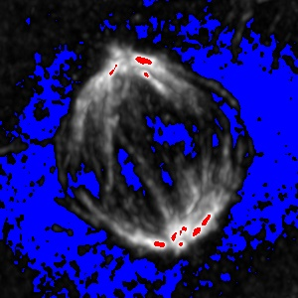
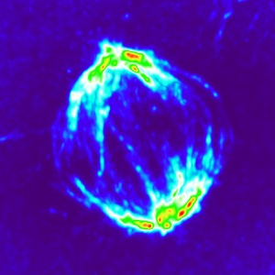
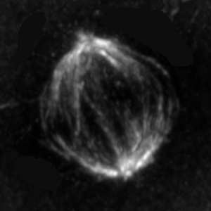
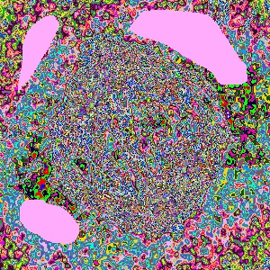
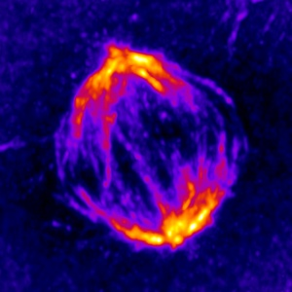
Some useful LUTs
Used for different purposes:
HiLo
Fire
Thermal
Glasbey
HiLo
Thermal
Fire
Glasbey
Notes:
Hilo allows to see saturation
Glasbey lut is good useful to see which areas of the image have the same pixel values. Show a quick demo of glasbey on count masks using blobs

Slide 9
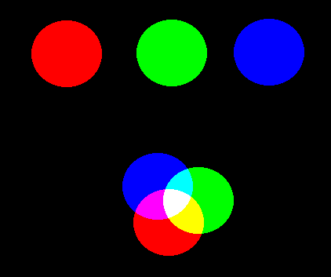
RGB
In RGB (Red, Green, Blue) images, colors are made of components of the 3 basic colors:
Red
Green
Blue
(255, 0, 0)
(0, 255, 0)
(0, 0, 255)
(0, 255, 255)
(255, 0, 255)
(255, 255, 255)

Slide 10
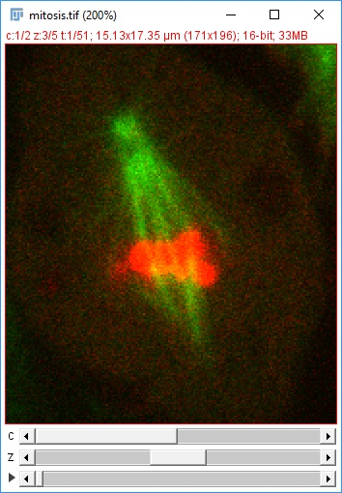
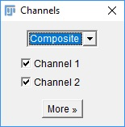
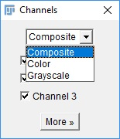
Composite Images vs RGB Images
Multidimensional image in ImageJ is a Composite image (C, Z, T)
Channels can have original pixel values,
Color is false; pseudocolor,
Can work on channels independently,
Open Samples > Mitosis (5D stack)
Channels Tool
Image > Color > Channels Tool
More dimensions are just more images in another channel, time or z-plane (normally)
Notes:
Some imageJ functions duplicate images.
Spend time to explain what are the dimensions

Slide 11
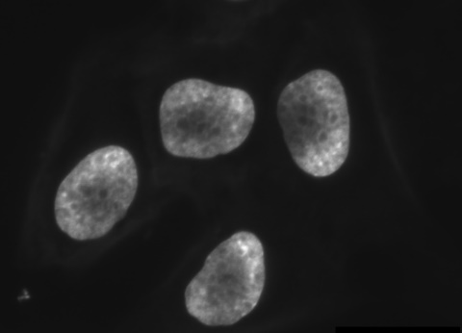
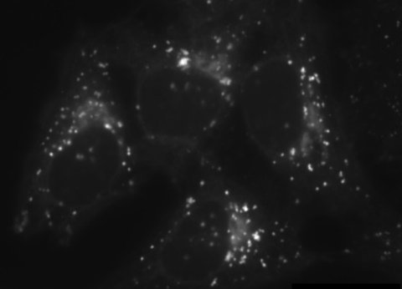
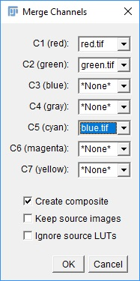
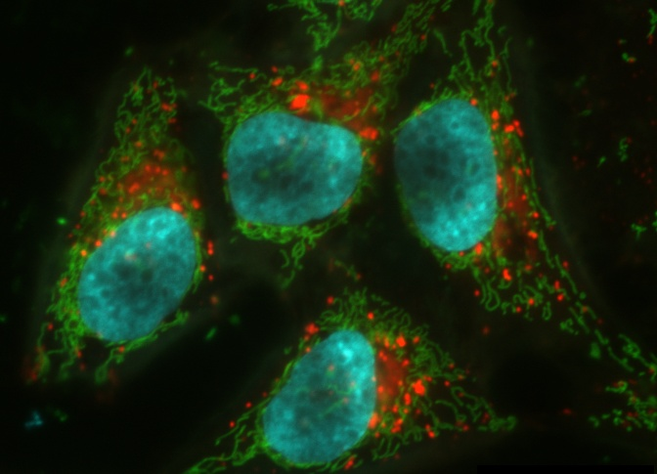
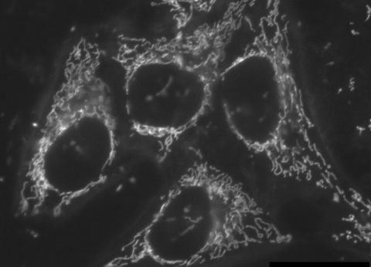
Creating a composite image
Get channel images:
Open samples > Hela Cells
Image > Split Channels
Image > Color > Merge Channels
Select on image per channel/color
Experiment with the bottom options (or whatever options you want)
Notes:
Drive home the fact that you can always change later de color of each channel.

Slide 12
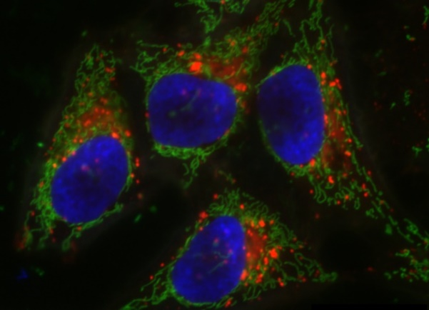

Composite to RGB
Create a composite image by merging previous channels,
As red, green and blue.
Convert to RGB,
Image > Type > RGB color
Or
Channels Tool > More... > Convert to RGB
Split channels of the RGB image
Do the same again but Cyan instead of Blue
Split channels and see what happens to all channels when you split the RGB image.
which channel is different?

Slide 13
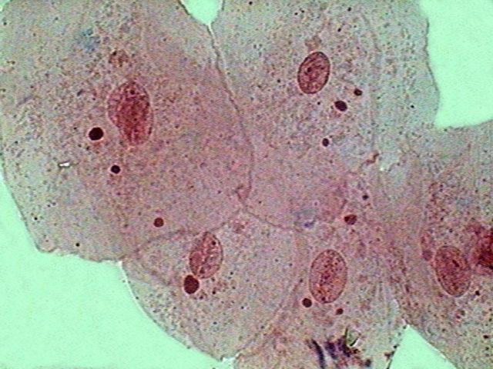
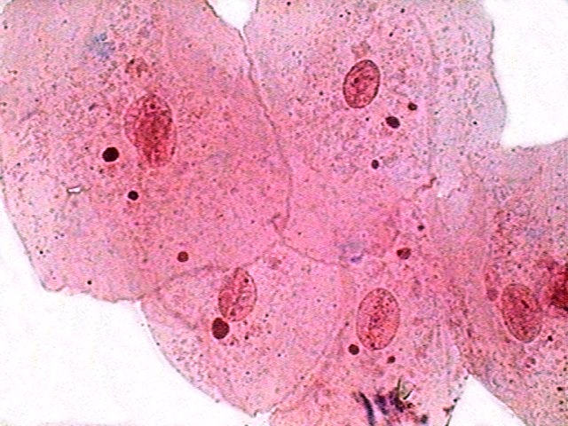
Working with RGB images
When working with color images, these may need to be adjusted.
Colors need to be adjusted manually when acquisition software doesn’t.
ImageJ/Fiji has the tools to do it
Color Histogram
Color Balance

Slide 14
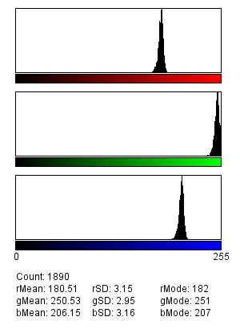
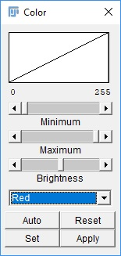
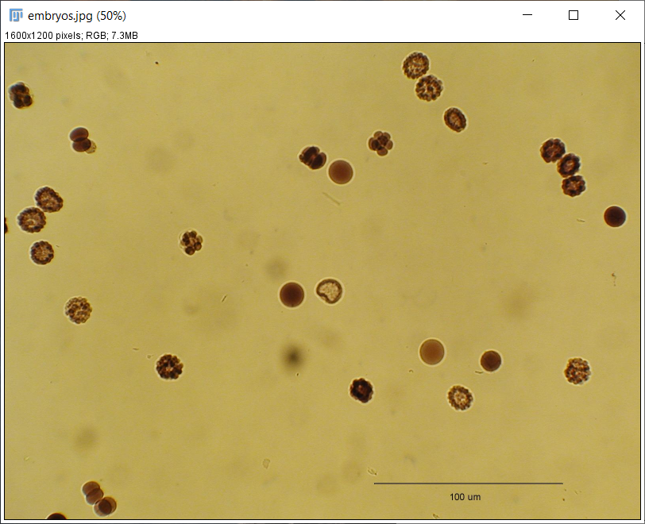
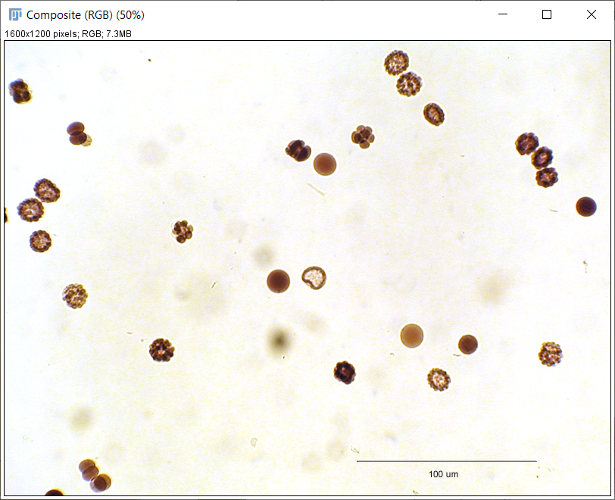
Adjusting RGB images
Open Samples > embryos. Draw a ROI in a white region
Analyze the color histogram
Analyze > Color Histogram
Check the average levels for 3 colors (Red, Green, Blue)
Open the color balance tool
Image > Adjust > Color Balance
Set the Maximum Red value to the rMean.
Repeat for other 2 channels.
Notes:
There’s an alternative way.

Slide 15
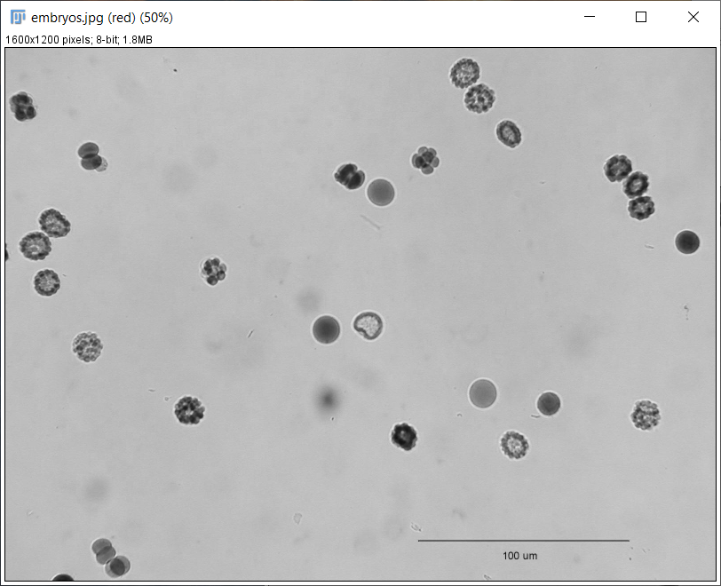
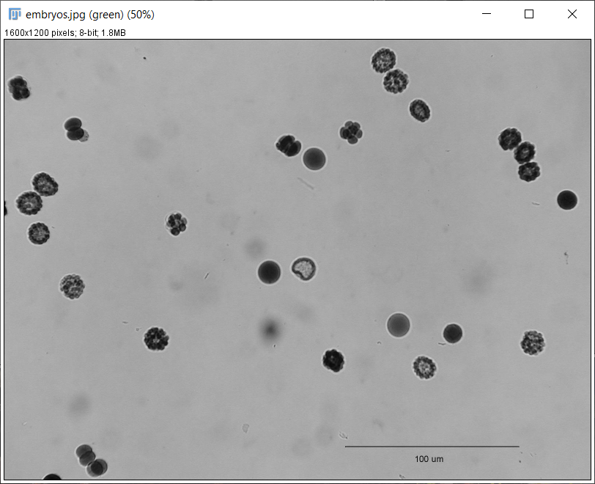
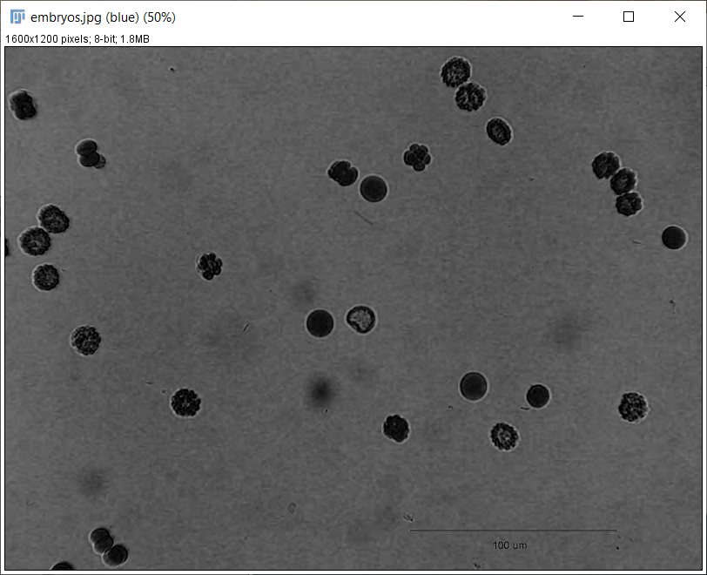
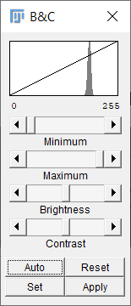
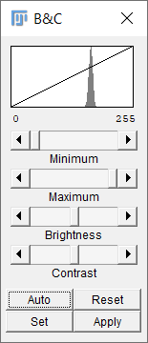
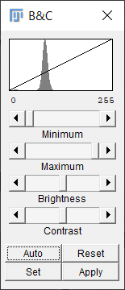
Adjusting RGB images
Another way of doing the same thing - Split channels and adjust each channel individually.
Red
Green
Blue
Adjust histograms
Merge them. Make sure to use the correct colors for the correct image.

Slide 16
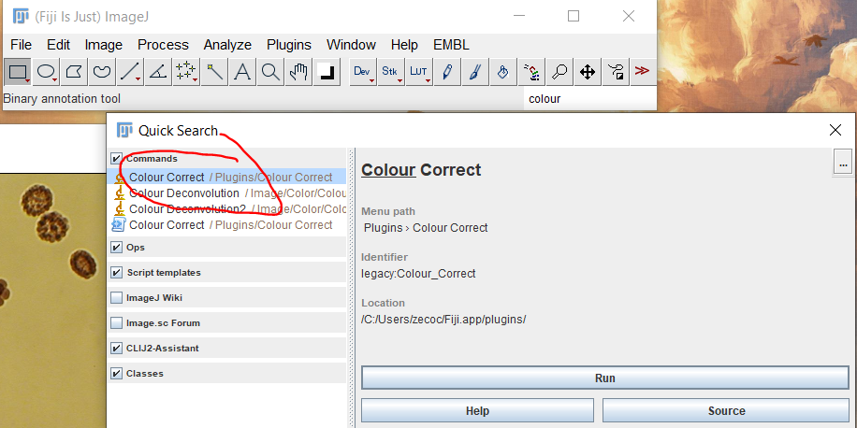
Adjusting RGB images but using a plugin
Cool thing about Fiji – Most likely there’s a plugin that solves your issue.
For color correction, there’s an old plugin called “Colour Correct”. You can find it here - https://blog.bham.ac.uk/intellimic/g-landini-software/
Download the zip file from the github page https://github.com/landinig/IJ-Colour_Correct/blob/main/colour_correct.zip
Unzip inside your Fiji plugins folder.
Restart Fiji.
Follow plugins instructions.

Slide 17
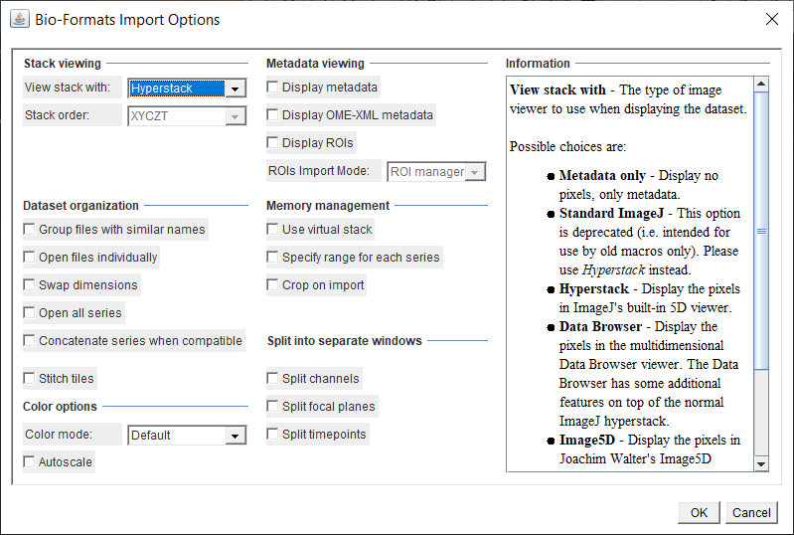
Installing other plugins and Bio-Formats
Open Convallaria_10x.czi

Slide 18
Installing other plugins and Bio-Formats
Fiji update site:
- Help > Update… (the 3 dots are intentional)
Bio-formats info https://imagej.net/formats/bio-formats

Slide 19
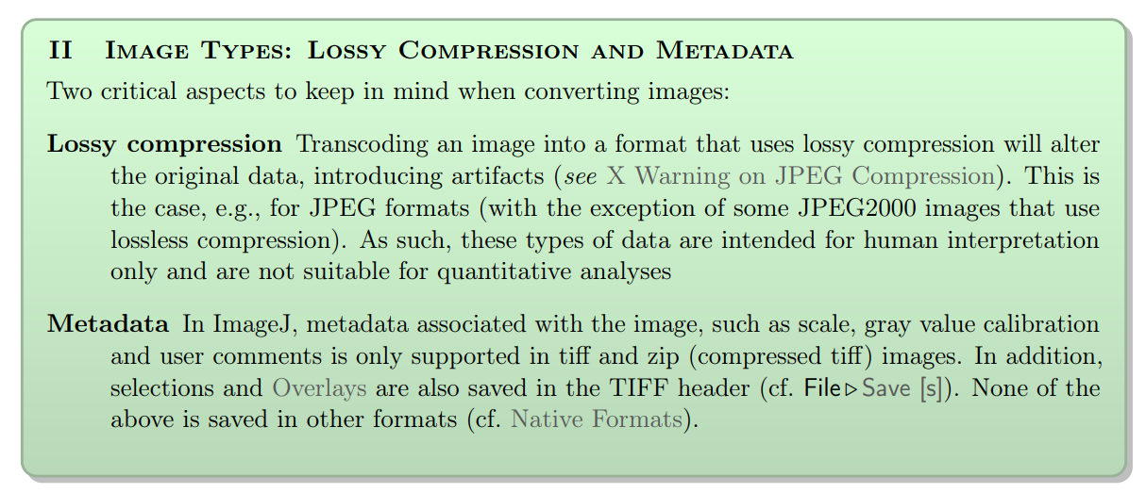
Saving images

Slide 20
Lossy vs. Lossless
Format | Name | 8 bit | 16 bit | 32 bit | RGB | stacks | hyper-stacks | Overlays in header | Transpa-rency | Compression
TIFF | Tagged Image File Format | √ | √ | √ | √ | √ | √ | √ | √ | lossless
JPEG | Join Photographic Expert Group File | √ |  |  | √ |  |  |  |  | lossy
GIF | Graphics Interchange Format | √ |  |  | √ | √ |  |  | √ | lossless
PNG | Portable Network Graphics File Format | √ | √ |  |  |  |  |  | √ | lossless
BMP | Bitmap Image Files | √ |  |  | √ |  |  |  | √ | lossless
DICOM | Digital Imaging and Communications in Medicine | √ | √ | √ | √ | √ | √ |  | √ | lossless

Slide 21
Saving images
Good rule of thumb:
TIFF to process and analyze images
PNGs are normally good for publication, but that depends on the journal
JPEG are good to put images in your lab meetings and presentations.
For Big data files (> 500 GB), there are H5, N5 and NGFF image file formats. But that’s for another time.

